Slide 1

Lex & Yacc Tutorial

Slide 2
References
*Tom Niemann. “A Compact Guide to Lex & Yacc ”. Portland, Oregon. 18 April 2010
*Levine, John R., Tony Mason and Doug Brown [1992]. Lex & Yacc. O’Reilly & Associates, Inc. Sebastopol, California.
Hathal & Ahmad

Slide 3
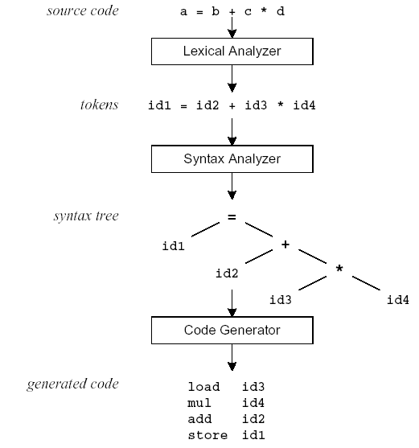
Compilation Sequence
Program source
(stream of characters)
Tokens
Parse Tree

Slide 4
Overview
Take a glance at Lex!

Slide 5
What is Lex?
The main job of a lexical analyzer (scanner) is to break up an input stream into more usable elements (tokens)
  a = b + c * d;
  ID ASSIGN ID PLUS ID MULT ID SEMI
Lex is an utility to help you rapidly generate your scanners

Slide 6
Lex – Lexical Analyzer
Lexical analyzers tokenize input streams
Tokens are the terminals of a language
  English
    words, punctuation marks, …
  Programming language
    Identifiers, operators, keywords, …
Regular expressions define terminals/tokens

Slide 7
An Overview of Lex
Lex source program
Lex
lex.yy.c
lex.yy.c
C compiler
a.out
input
a.out
tokens

Slide 8
Lex
lex is a program (generator) that generates lexical analyzers, (widely used on Unix). also known as tokenizers,
It is mostly used with Yacc parser generator.
Written by Eric Schmidt and Mike Lesk.
It reads the input stream (specifying the lexical analyzer ) and outputs source code implementing the lexical analyzer in the C programming language.
Lex will read patterns (regular expressions); then produces C code for a lexical analyzer that scans for identifiers.
Hathal & Ahmad

Slide 9
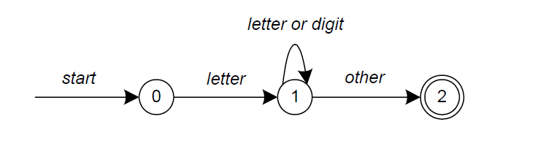
Lex
  A simple pattern: letter(letter|digit)*
Regular expressions are translated by lex to a computer program that mimics an FSA.
This pattern matches a string of characters that begins with a single letter followed by zero or more letters or digits.
Hathal & Ahmad

Slide 10
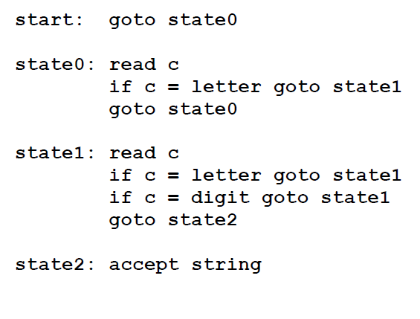
Lex
Some limitations, Lex cannot be used to recognize nested structures such as parentheses, since it only has states and transitions between states.
So, Lex is good at pattern matching, while Yacc is for more challenging tasks.
Hathal & Ahmad

Slide 11
Lex Source
Lex source is separated into three sections by %% delimiters
The general format of Lex source is
The absolute minimum Lex program is thus
{definitions}
%%
{transition rules}
%%
{user subroutines}
(required)
(optional)
%%

Slide 12

Lex
file: lex.yy.c
lex input spec (regexps + actions)
yylex()
{
…
}
lex
compiler
user supplies
driver code
main() {…}
or
parser() {…}
Hathal & Ahmad

Slide 13
Lex vs. Yacc
Lex
  Lex generates C code for a lexical analyzer, or scanner
  Lex uses patterns that match strings in the input and converts the strings to tokens
Yacc
  Yacc generates C code for syntax analyzer, or parser.
  Yacc uses grammar rules that allow it to analyze tokens from Lex and create a syntax tree.
Hathal & Ahmad

Slide 14
Lex with Yacc
Lex source
(Lexical Rules)
Yacc source
(Grammar Rules)
Lex
Yacc
lex.yy.c
y.tab.c
call
yylex()
yyparse()
Parsed
Input
Input
return token
Hathal & Ahmad

Slide 15

Lex Source Program
Lex source is a table of
  regular expressions and
  corresponding program fragments (actions)
digit [0-9]
letter [a-zA-Z]
%%
%%
int main() {
yylex();
return 0;
}
{letter}({letter}|{digit})* { printf(“id: %s\n”, yytext);}
.|\n {/* Ignore all other characters. */}

Slide 16
Example
A flex program to read a file of (positive) integers and compute the average:
%{
#include <stdio.h>
#include <stdlib.h>
%}
dgt [0-9]
%%
{dgt}+ return atoi(yytext);
%%
void main()
{
int val, total = 0, n = 0;
while ( (val = yylex()) > 0 ) {
total += val;
n++;
}
if (n > 0) printf(“ave = %d\n”, total/n);
}
Lex Tutorial

Slide 17
Example
A flex program to read a file of (positive) integers and compute the average:
%{
#include <stdio.h>
#include <stdlib.h>
%}
dgt [0-9]
%%
{dgt}+ return atoi(yytext);
%%
void main()
{
int val, total = 0, n = 0;
while ( (val = yylex()) > 0 ) {
total += val;
n++;
}
if (n > 0) printf(“ave = %d\n”, total/n);
}
Definition for a digit
definitions
Rule to match a number and return its value to the calling routine
rules
Driver code
(could instead have been in a separate file)
user code
Lex Tutorial

Slide 18
Example
A flex program to read a file of (positive) integers and compute the average:
%{
#include <stdio.h>
#include <stdlib.h>
%}
dgt [0-9]
%%
{dgt}+ return atoi(yytext);
%%
void main()
{
int val, total = 0, n = 0;
while ( (val = yylex()) > 0 ) {
total += val;
n++;
}
if (n > 0) printf(“ave = %d\n”, total/n);
}
definitions
defining and using a name
rules
user code
Lex Tutorial

Slide 19
Example
A flex program to read a file of (positive) integers and compute the average:
%{
#include <stdio.h>
#include <stdlib.h>
%}
dgt [0-9]
%%
{dgt}+ return atoi(yytext);
%%
void main()
{
int val, total = 0, n = 0;
while ( (val = yylex()) > 0 ) {
total += val;
n++;
}
if (n > 0) printf(“ave = %d\n”, total/n);
}
defining and using a name
definitions
char * yytext;
  a buffer that holds the input characters that actually match the pattern
rules
user code
Lex Tutorial

Slide 20
Example
A flex program to read a file of (positive) integers and compute the average:
%{
#include <stdio.h>
#include <stdlib.h>
%}
dgt [0-9]
%%
{dgt}+ return atoi(yytext);
%%
void main()
{
int val, total = 0, n = 0;
while ( (val = yylex()) > 0 ) {
total += val;
n++;
}
if (n > 0) printf(“ave = %d\n”, total/n);
}
defining and using a name
definitions
char * yytext;
  a buffer that holds the input characters that actually match the pattern
rules
user code
Invoking the scanner: yylex()
  Each time yylex() is called, the scanner continues processing the input from where it last left off.
  Returns 0 on end-of-file.
Lex Tutorial

Slide 21
Matching the Input
When more than one pattern can match the input, the scanner behaves as follows:
  the longest match is chosen;
  if multiple rules match, the rule listed first in the flex input file is chosen;
  if no rule matches, the default is to copy the next character to stdout.
The text that matched (the “token”) is copied to a buffer yytext.
Lex Tutorial

Slide 22
Lex Regular Expressions
(Extended Regular Expressions)
A regular expression matches a set of strings
Regular expression
  Operators
  Character classes
  Arbitrary character
  Optional expressions
  Alternation and grouping
  Context sensitivity
  Repetitions and definitions

Slide 23
Operators
“ \ [ ] ^ - ? . * + | ( ) $ / { } % < >
If they are to be used as text characters, an escape should be used
\$ = “$”
\\ = “\”
Every character but blank, tab (\t), newline (\n) and the list above is always a text character

Slide 24
Character Classes []
[abc] matches a single character, which may be a, b, or c
Every operator meaning is ignored except \ - and ^
e.g.
[ab] => a or b
[a-z] => a or b or c or … or z
[-+0-9] => all the digits and the two signs
[^a-zA-Z] => any character which is not a
letter

Slide 25
Arbitrary Character .
To match almost character, the operator character . is the class of all characters except newline
[\40-\176] matches all printable characters in the ASCII character set, from octal 40 (blank) to octal 176 (tilde~)

Slide 26
Optional & Repeated Expressions
a? => zero or one instance of a
a* => zero or more instances of a
a+ => one or more instances of a
E.g.
ab?c => ac or abc
[a-z]+ => all strings of lower case letters
[a-zA-Z][a-zA-Z0-9]* => all alphanumeric strings with a leading alphabetic character

Slide 27
Precedence of Operators
Level of precedence
  Kleene closure (*), ?, +
  concatenation
  alternation (|)
All operators are left associative.
Ex: a*b|cd* = ((a*)b)|(c(d*))

Slide 28
Pattern Matching Primitives
Metacharacter | Matches
. | any character except newline
\n | newline
* | zero or more copies of the preceding expression
+ | one or more copies of the preceding expression
? | zero or one copy of the preceding expression
^ | beginning of line / complement
$ | end of line
a|b | a or b
(ab)+ | one or more copies of ab (grouping)
[ab] | a or b
a{3} | 3 instances of a
“a+b” | literal “a+b” (C escapes still work)
PLLab, NTHU,Cs2403 Programming Languages

Slide 29
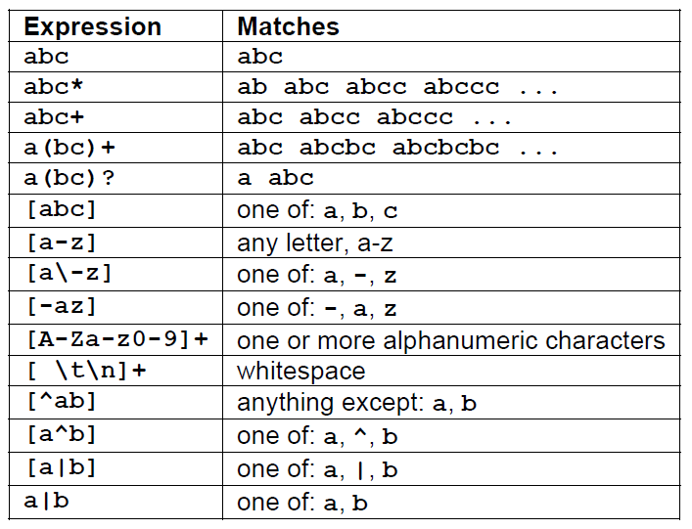
Pattern Matching examples

Slide 30
Transition Rules
  pattern { action }
regexp <one or more blanks> action (C code);
regexp <one or more blanks> { actions (C code) }
A null statement ; will ignore the input (no actions)
[ \t\n] ;
  Causes the three spacing characters to be ignored
Hathal & Ahmad

Slide 31
Transition Rules (cont’d)
Four special options for actions:
|, ECHO;, BEGIN, and REJECT;
| indicates that the action for this rule is from the action for the next rule
  [ \t\n] ;
  “ “ |
“\t” |
“\n” ;
The unmatched token is using a default action that ECHO from the input to the output

Slide 32
Transition Rules (cont’d)
REJECT
  Go do the next alternative
…
%%
pink {npink++; REJECT;}
ink {nink++; REJECT;}
pin {npin++; REJECT;}
. |
\n ;
%%
…
Hathal & Ahmad

Slide 33
Lex Source to C Program
The table is translated to a C program (lex.yy.c) which
  reads an input stream
  partitioning the input into strings which match the given expressions and
  copying it to an output stream if necessary

Slide 34
Lex Predefined Variables
yytext -- a string containing the lexeme
yyleng -- the length of the lexeme
yyin -- the input stream pointer
  the default input of default main() is stdin
yyout -- the output stream pointer
  the default output of default main() is stdout.
cs20: %./a.out < inputfile > outfile
E.g.
  [a-z]+ printf(“%s”, yytext);
  [a-z]+ ECHO;
  [a-zA-Z]+ {words++; chars += yyleng;}

Slide 35
Lex Library Routines
yylex()
  The default main() contains a call of yylex()
yymore()
  return the next token
yyless(n)
  retain the first n characters in yytext
yywarp()
  is called whenever Lex reaches an end-of-file
  The default yywarp() always returns 1

Slide 36
Review of Lex Predefined Variables
Name | Function
char *yytext | pointer to matched string
int yyleng | length of matched string
FILE *yyin | input stream pointer
FILE *yyout | output stream pointer
int yylex(void) | call to invoke lexer, returns token
char* yymore(void) | return the next token
int yyless(int n) | retain the first n characters in yytext
int yywrap(void) | wrapup, return 1 if done, 0 if not done
ECHO | write matched string
REJECT | go to the next alternative rule
INITAL | initial start condition
BEGIN | condition switch start condition

Slide 37
User Subroutines Section
You can use your Lex routines in the same ways you use routines in other programming languages.
%{
void foo();
%}
letter [a-zA-Z]
%%
{letter}+ foo();
%%
…
void foo() {
…
}

Slide 38
User Subroutines Section (cont’d)
The section where main() is placed
%{
int counter = 0;
%}
letter [a-zA-Z]
%%
{letter}+ {printf(“a word\n”); counter++;}
%%
main() {
yylex();
printf(“There are total %d words\n”, counter);
}

Slide 39
Usage
To run Lex on a source file, type
flex scanner.l
It produces a file named lex.yy.c which is a C program for the lexical analyzer.
To compile and link lex.yy.c, type
gcc lex.yy.c –lfl
To run the lexical analyzer program, type
./a.out < inputfile

Slide 40
Versions of Lex
AT&T -- lex
http://www.combo.org/lex_yacc_page/lex.html
GNU -- flex
http://www.gnu.org/manual/flex-2.5.4/flex.html
a Win32 version of flex :
http://www.monmouth.com/~wstreett/lex-yacc/lex-yacc.html
or Cygwin :
http://sources.redhat.com/cygwin/
Lex on different machines is not created equal.

Slide 41
YACC - YET ANOTHER COMPILER-COMPILER
Hathal & Ahmad

Slide 42
Introduction
Page- 287
What is YACC ?Yacc is a LALR parser.
Precedence, association.
Left means left to right
Right means Right to left.
Yacc ask to lex what is +,-,12.
  Tool which will produce a parser for a given grammar.
  YACC (Yet Another Compiler Compiler) is a program designed to compile a LALR(1) grammar and to produce the source code of the syntactic analyzer of the language produced by this grammar.
Hathal & Ahmad

Slide 43
How YACC Works
File containing desired
grammar in yacc format
gram.y
File containing desired
grammar in yacc format
yacc
yacc program
y.tab.c
C source program created by yacc
cc
or gcc
C compiler
a.out
Executable program that will parse
grammar given in gram.y

Slide 44



How YACC Works
y.tab.h
yacc
YACC source (*.y)
y.tab.c
y.output
(1) Parser generation time
C compiler/linker
y.tab.c
a.out
(2) Compile time
Abstract
Syntax
Tree
a.out
Token stream
(3) Run time

Slide 45
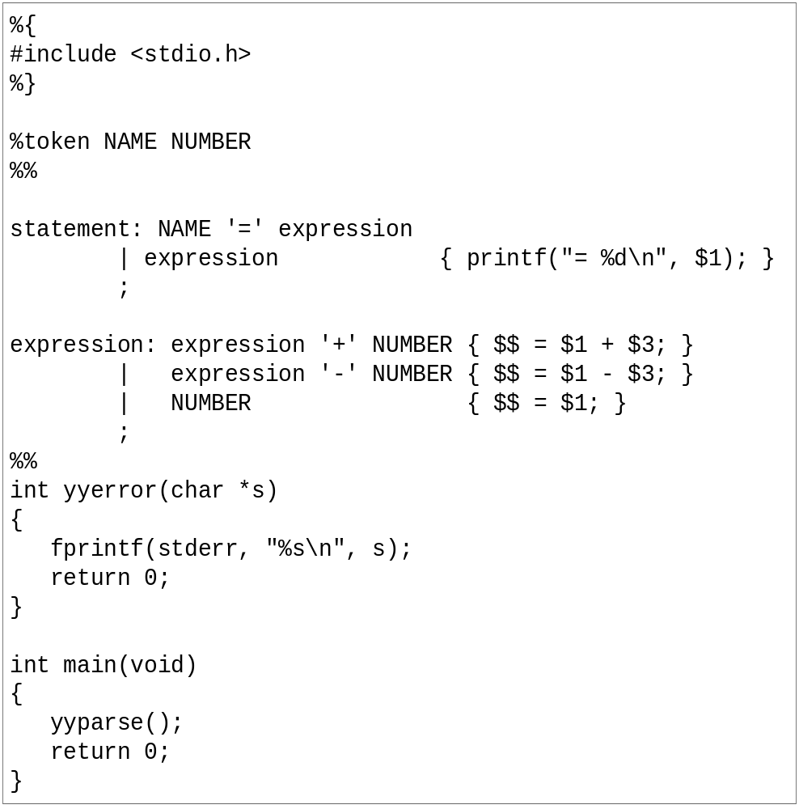
An YACC File Example
… definitions …
%%
… rules …
%%
… subroutines …

Slide 46
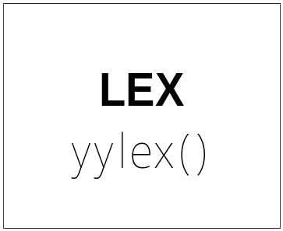
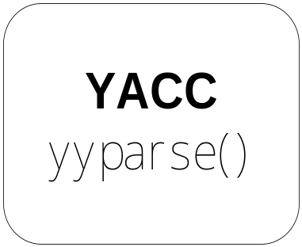
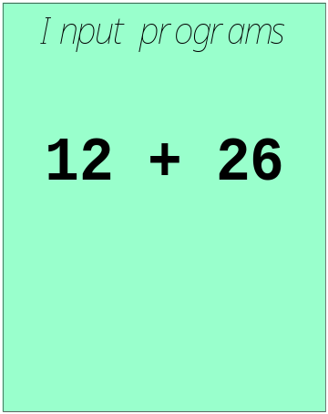

Works with Lex
How to work ?

Slide 47


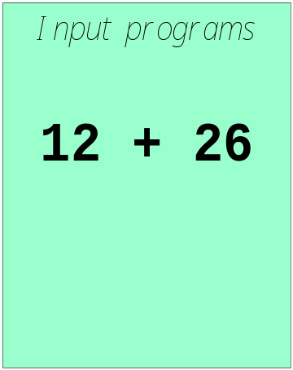
Works with Lex
[0-9]+
call yylex()
next token is NUM
NUM ‘+’ NUM

Slide 48
YACC File Format
%{
  C declarations
  %}
  yacc declarations
  %%
  Grammar rules
  %%
  Additional C code
  Comments enclosed in /* ... */ may appear in any of the sections.

Slide 49
Definitions Section
%{
#include <stdio.h>
#include <stdlib.h>
%}
%token ID NUM
%start expr
It is a terminal
Start by expr parse

Slide 50
Start Symbol
The first non-terminal specified in the grammar specification section.
To overwrite it with %start declaraction.
%start non-terminal

Slide 51
Rules Section
This section defines grammar
Example
expr : expr '+' term | term;
term : term '*' factor | factor;
factor : '(' expr ')' | ID | NUM;

Slide 52
Rules Section
Normally written like this
Semantic action means is it meaningful.
Example:
expr : expr '+' term
| term
;
term : term '*' factor
| factor
;
factor : '(' expr ')'
| ID
| NUM
;

Slide 53
The Position of Rules
expr : expr '+' term { $$ = $1 + $3; }
| term { $$ = $1; }
;
term : term '*' factor { $$ = $1 * $3; }
| factor { $$ = $1; }
;
factor : '(' expr ')' { $$ = $2; }
| ID
| NUM
;

Slide 54
The Position of Rules
$1
expr : expr '+' term { $$ = $1 + $3; }
| term { $$ = $1; }
;
term : term '*' factor { $$ = $1 * $3; }
| factor { $$ = $1; }
;
factor : '(' expr ')' { $$ = $2; }
| ID
| NUM
;

Slide 55
The Position of Rules
expr : expr '+' term { $$ = $1 + $3; }
| term { $$ = $1; }
;
term : term '*' factor { $$ = $1 * $3; }
| factor { $$ = $1; }
;
factor : '(' expr ')' { $$ = $2; }
| ID
| NUM
;
$2

Slide 56
The Position of Rules
expr : expr '+' term { $$ = $1 + $3; }
| term { $$ = $1; }
;
term : term '*' factor { $$ = $1 * $3; }
| factor { $$ = $1; }
;
factor : '(' expr ')' { $$ = $2; }
| ID
| NUM
;
$3
Default: $$ = $1;

Slide 57

Communication between LEX and YACC
[0-9]+
call yylex()
next token is NUM
NUM ‘+’ NUM
LEX and YACC
Need a method to confirm the identity token

Slide 58
Communication between LEX and YACC
%{
#include <stdio.h>
#include "y.tab.h"
%}
id [_a-zA-Z][_a-zA-Z0-9]*
%%
int { return INT; }
char { return CHAR; }
float { return FLOAT; }
{id} { return ID;}
scanner.l
%{
#include <stdio.h>
#include <stdlib.h>
%}
%token CHAR, FLOAT, ID, INT
%%
parser.y

Slide 59
YACC
Rules may be recursive
Rules may be ambiguous*
Uses bottom up Shift/Reduce parsing
  Get a token
  Push onto stack
  Can it reduced (How do we know?)
    If yes: Reduce using a rule
    If no: Get another token
Yacc cannot look ahead more than one token

Slide 60
Yacc Example
Taken from Lex & Yacc
Simple calculator
  a = 4 + 6
  a
  a=10
  b = 7
  c = a + b
  c
  c = 17
  $

Slide 61
Grammar
expression ::= expression '+' term |
expression '-' term |
term
term ::= term '*' factor |
term '/' factor |
factor
factor ::= '(' expression ')' |
'-' factor |
NUMBER |
NAME

Slide 62
Parser (cont’d)
statement_list: statement '\n'
| statement_list statement '\n'
;
statement: NAME '=' expression { $1->value = $3; }
| expression { printf("= %g\n", $1); }
;
expression: expression '+' term { $$ = $1 + $3; }
| expression '-' term { $$ = $1 - $3; }
| term
;
parser.y

Slide 63
Parser (cont’d)
term: term '*' factor { $$ = $1 * $3; }
| term '/' factor { if ($3 == 0.0)
yyerror("divide by zero");
else
$$ = $1 / $3;
}
| factor
;
factor: '(' expression ')' { $$ = $2; }
| '-' factor { $$ = -$2; }
| NUMBER { $$ = $1; }
| NAME { $$ = $1->value; }
;
%%
parser.y

Slide 64
Scanner
%{
#include "y.tab.h"
#include "parser.h"
#include <math.h>
%}
%%
([0-9]+|([0-9]*\.[0-9]+)([eE][-+]?[0-9]+)?) {
yylval.dval = atof(yytext);
return NUMBER;
}
[ \t] ; /* ignore white space */
scanner.l

Slide 65
Scanner (cont’d)
[A-Za-z][A-Za-z0-9]* { /* return symbol pointer */
yylval.symp = symlook(yytext);
return NAME;
}
"$" { return 0; /* end of input */ }
\n |”=“|”+”|”-”|”*”|”/” return yytext[0];
%%
scanner.l

Slide 66
YACC Command
Yacc (AT&T)
  yacc –d xxx.y

Slide 67
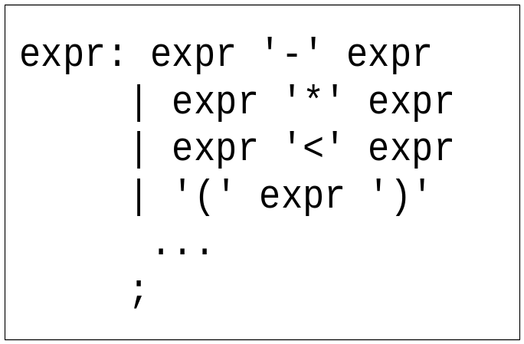
Precedence / Association
(1) 1 – 2 - 3
(2) 1 – 2 * 3
1-2-3 = (1-2)-3? or 1-(2-3)?
Define ‘-’ operator is left-association.
1-2*3 = 1-(2*3)
Define “*” operator is precedent to “-” operator

Slide 68
Precedence / Association
%right ‘=‘
%left '<' '>' NE LE GE
%left '+' '-‘
%left '*' '/'
highest precedence

Slide 69
Precedence / Association
expr : expr ‘+’ expr { $$ = $1 + $3; }
| expr ‘-’ expr { $$ = $1 - $3; }
| expr ‘*’ expr { $$ = $1 * $3; }
| expr ‘/’ expr
{
if($3==0)
yyerror(“divide 0”);
else
$$ = $1 / $3;
}
| ‘-’ expr %prec UMINUS {$$ = -$2; }

Slide 70
Shift/Reduce Conflicts
shift/reduce conflict
  occurs when a grammar is written in such a way that a decision between shifting and reducing can not be made.
  ex: IF-ELSE ambigious.
To resolve this conflict, yacc will choose to shift.

Slide 71
YACC Declaration Summary
`%start'
Specify the grammar's start symbol
`%union'
Declare the collection of data types that semantic values may have
`%token'
Declare a terminal symbol (token type name) with no precedence or
associativity specified
`%type'
Declare the type of semantic values for a nonterminal symbol

Slide 72
YACC Declaration Summary
`%right'
Declare a terminal symbol (token type name) that is
right-associative
`%left'
Declare a terminal symbol (token type name) that is left-associative
`%nonassoc'
Declare a terminal symbol (token type name) that is nonassociative
(using it in a way that would be associative is a syntax error,
ex: x op. y op. z is syntax error)

Slide 73
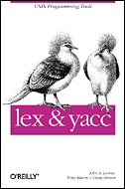
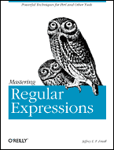
Reference Books
lex & yacc, 2nd Edition
  by John R.Levine, Tony Mason & Doug Brown
  O’Reilly
  ISBN: 1-56592-000-7
Mastering Regular Expressions
  by Jeffrey E.F. Friedl
  O’Reilly
  ISBN: 1-56592-257-3

